Slide 1

City of Oak Hill
Traffic Calming
January 9, 2024

Slide 2
Oak Hill

Slide 3
Metro Nashville / NDOT
Neighborhood Street Traffic Calming (NSTC) Program
https://www.nashville.gov/departments/transportation/plans-and-programs/traffic-calming

Slide 4
Definition
“The primary purpose of traffic calming is to support the livability and vitality of residential and commercial areas through improvements in non-motorist safety, mobility, and comfort. These objectives are typically achieved by reducing vehicle speeds or volumes on a single street or a street network. Traffic calming measures consist of horizontal, vertical, lane narrowing, roadside, and other features that use self-enforcing physical or psycho-perception means to produce desired effects.”
Source: Traffic Calming ePrimer by FHWA and ITE
Source: https://highways.dot.gov/safety/speed-management/traffic-calming-eprimer

Slide 5
Definition
Residential Streets
Improve Safety
Reduce Vehicle Speeds

Slide 6
The 3 “E’s”
Education
Enforcement
Engineering

Slide 7
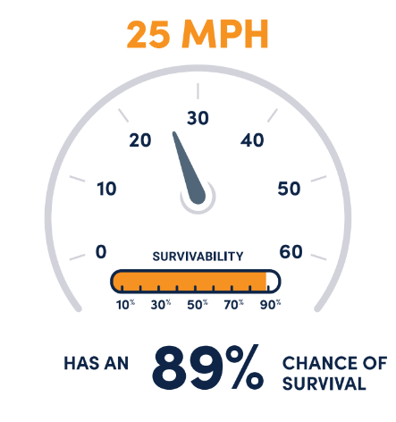
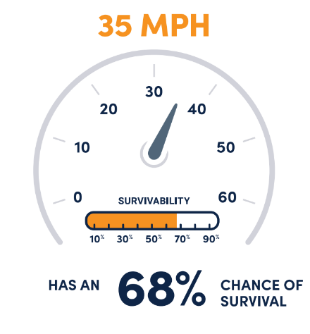
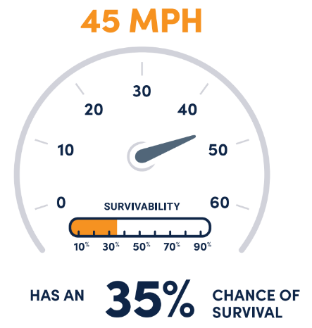
Safety & Vision Zero
Source: National Transportation Safety Board, 2017
Source: Nashville Vision Zero Action Plan 2022-2026, February 2022 (adopted August 2022)

Slide 8
Toolbox
Horizontal
Vertical
Lane Narrowing
Roadside

Slide 9
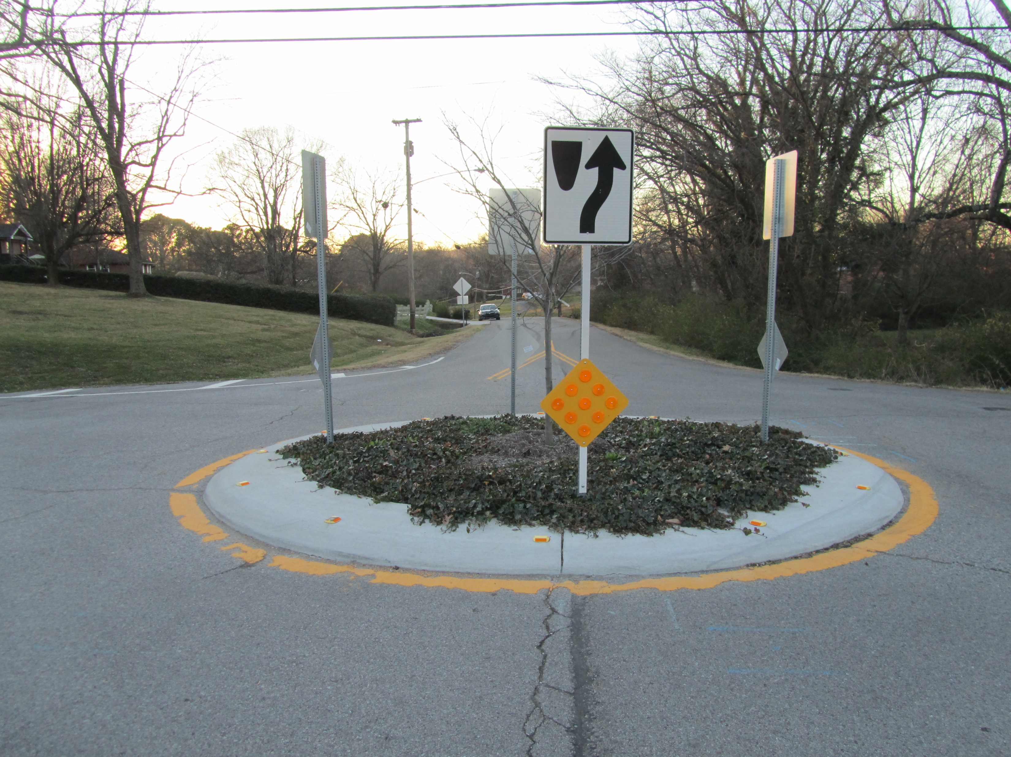
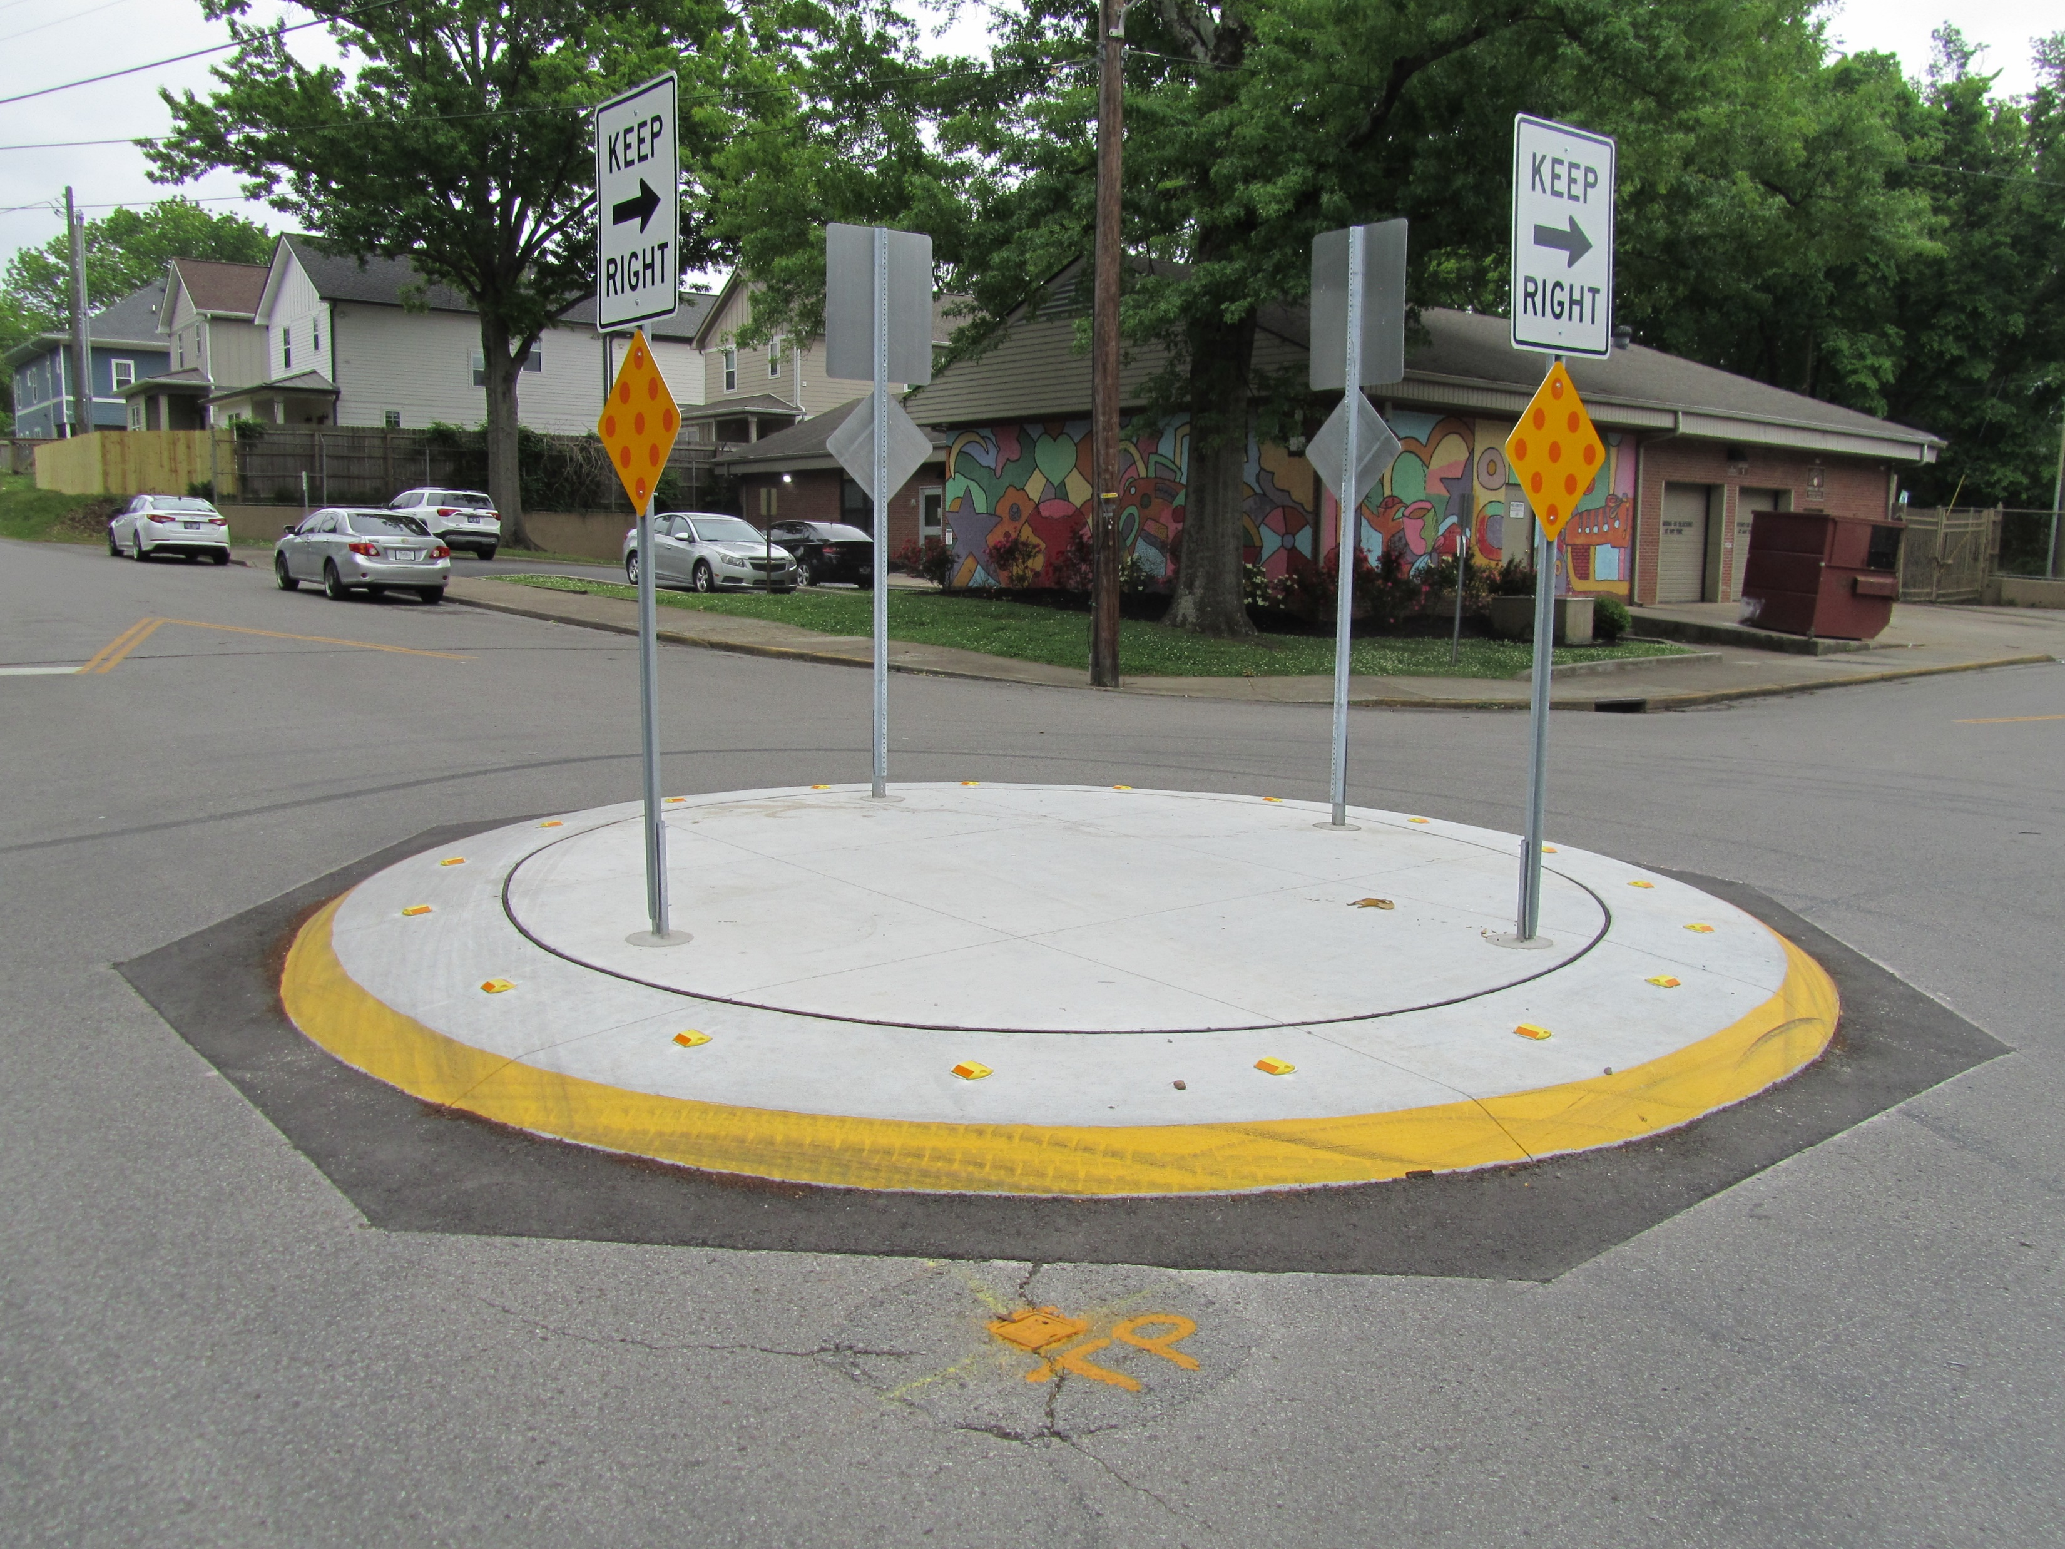
Horizontal
Traffic Circle

Slide 10
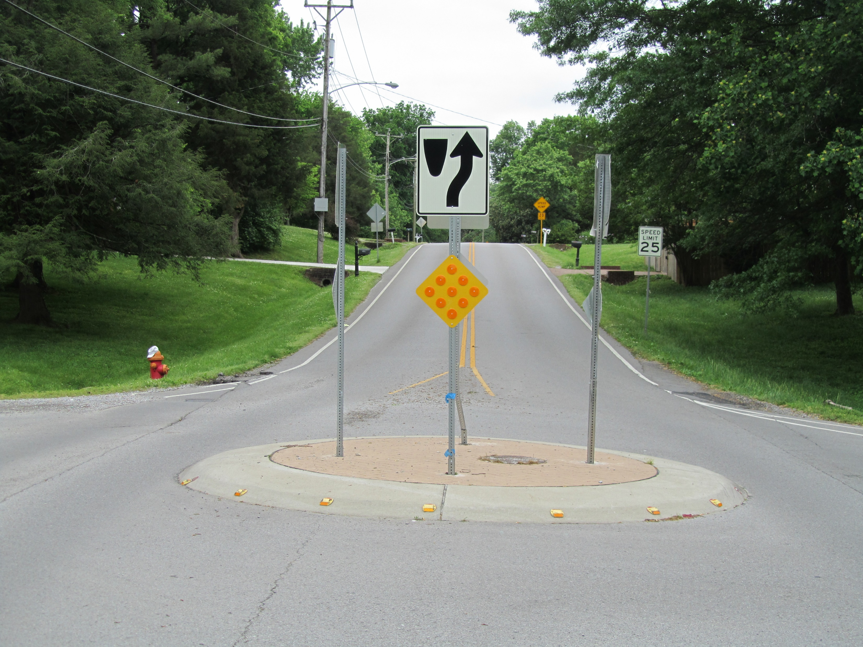
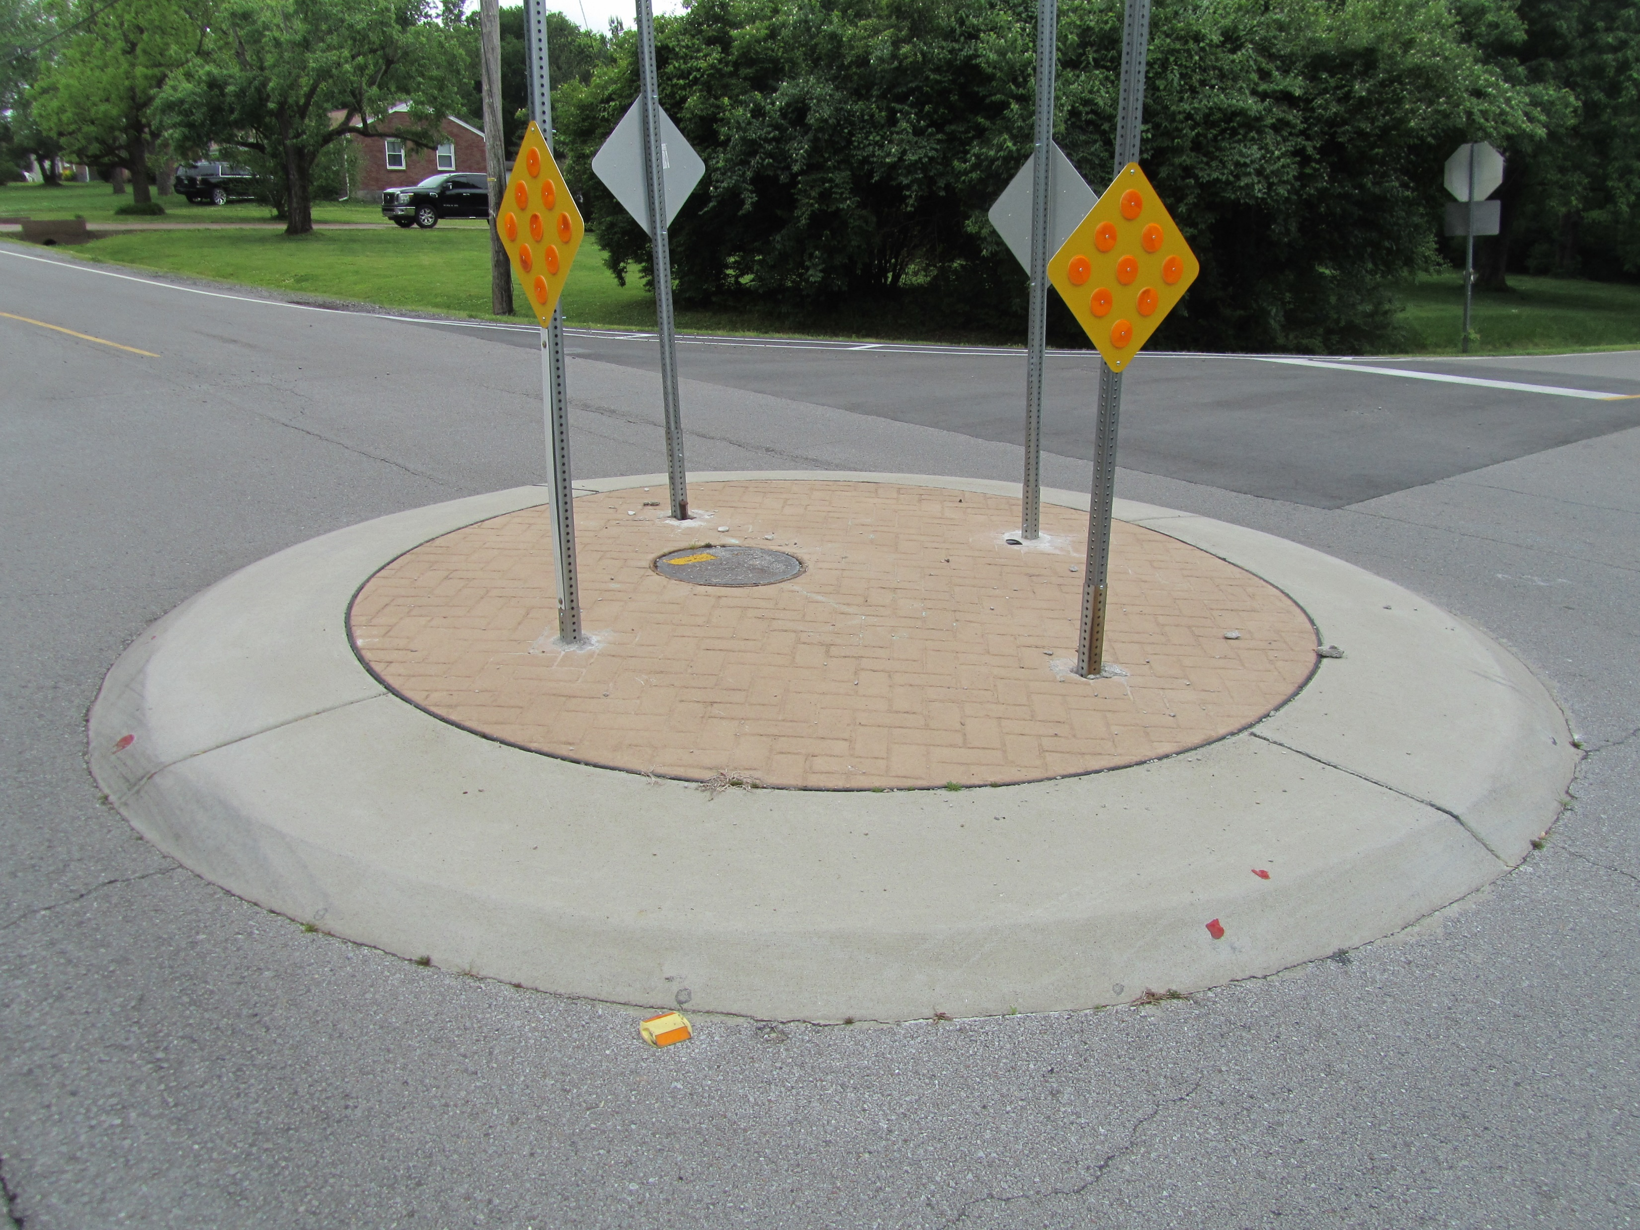
Horizontal
Traffic Circle

Slide 11
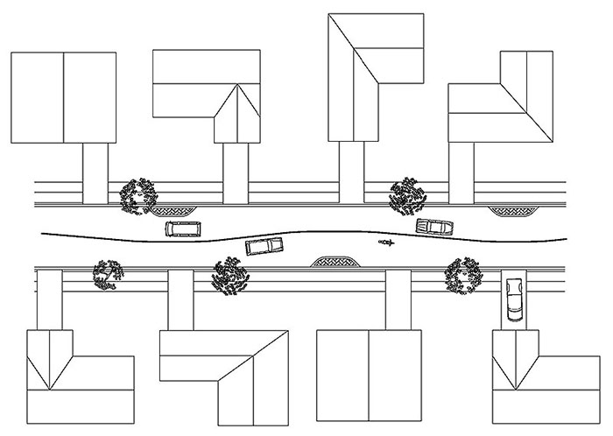
Horizontal
Chicane
Source: Delaware Department of Transportation
Source: https://highways.dot.gov/safety/speed-management/traffic-calming-eprimer

Slide 12
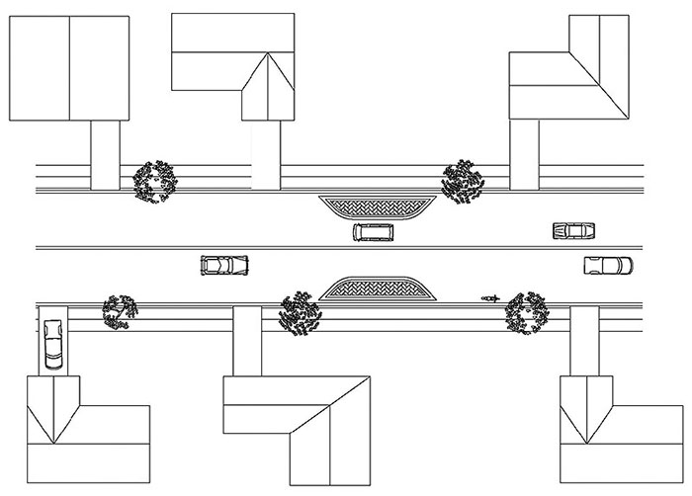
Horizontal
Choker
Source: Delaware Department of Transportation
Source: https://highways.dot.gov/safety/speed-management/traffic-calming-eprimer

Slide 13
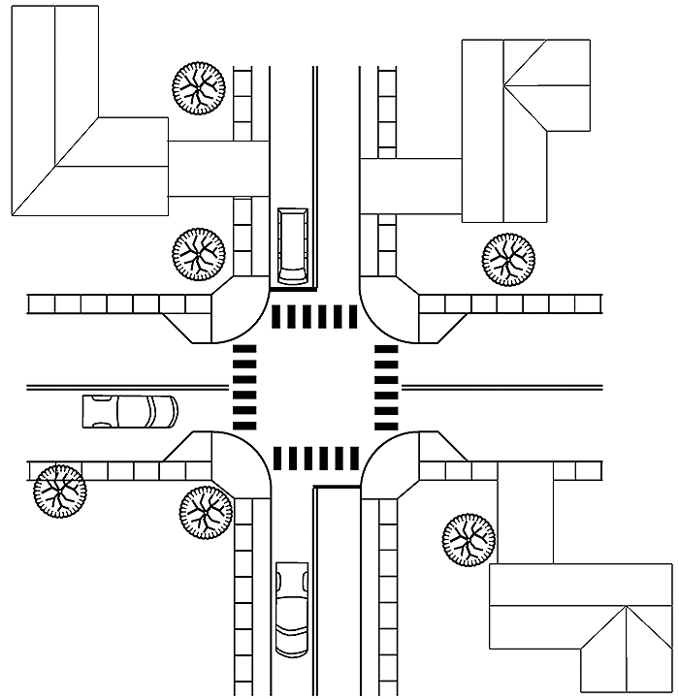
Horizontal
Corner Extension
(Bulb-Out)
Source: Delaware Department of Transportation
Source: https://highways.dot.gov/safety/speed-management/traffic-calming-eprimer

Slide 14
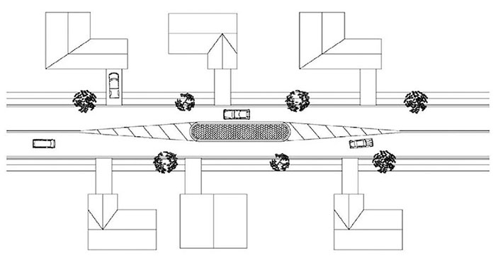
Horizontal
Median Island
Source: Delaware Department of Transportation
Source: https://highways.dot.gov/safety/speed-management/traffic-calming-eprimer

Slide 15
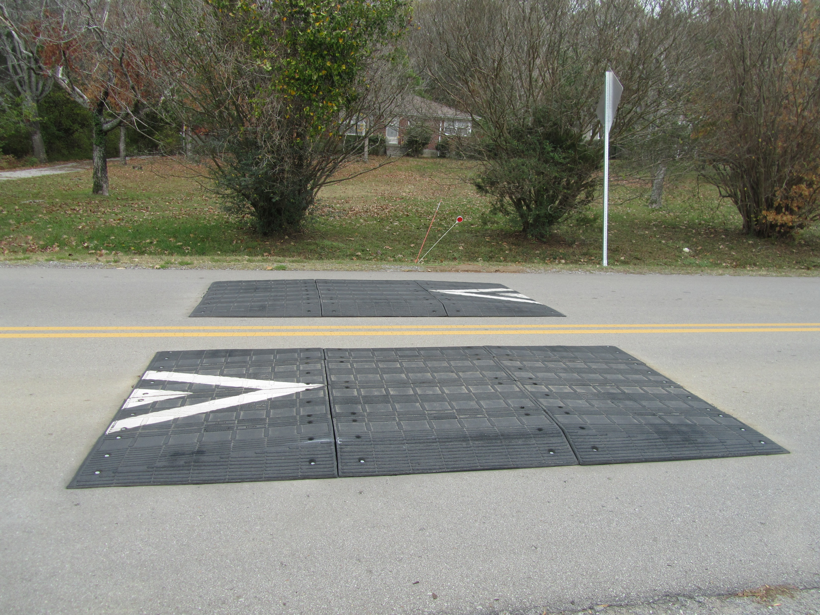
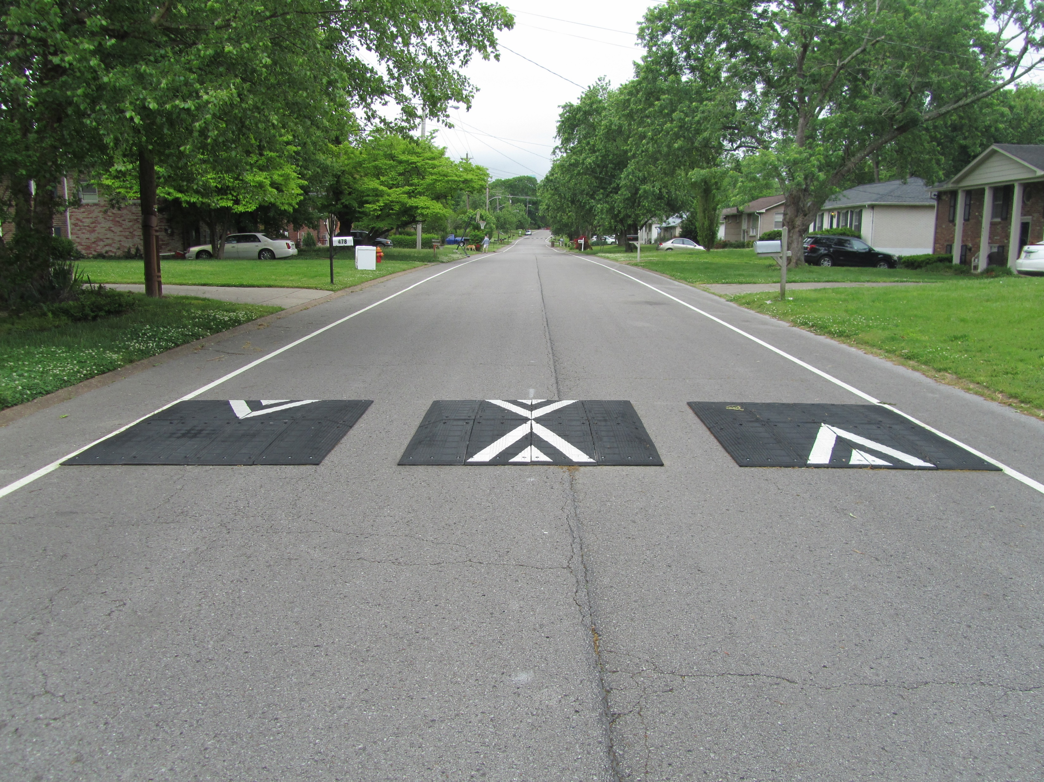
Vertical
Speed Cushion

Slide 16
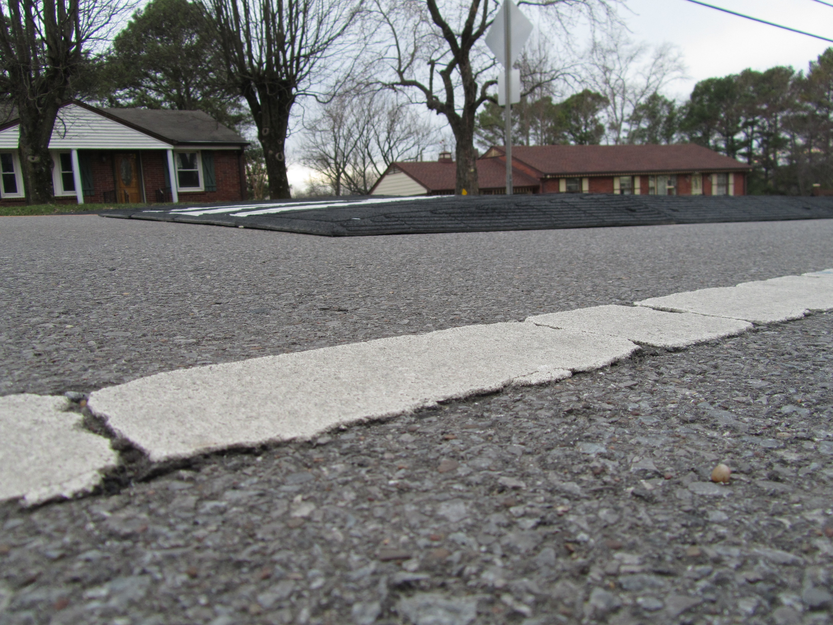
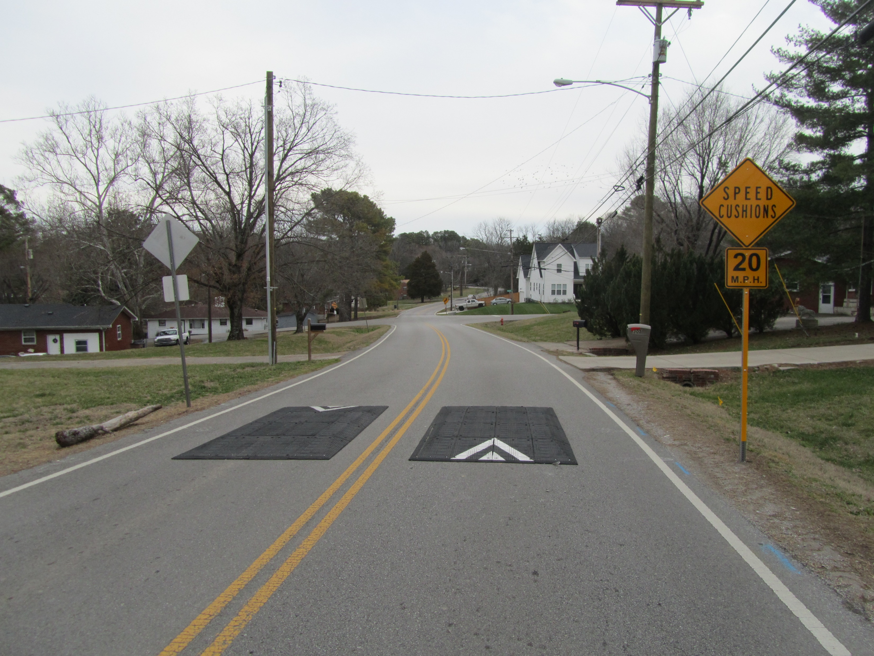
Vertical
Speed Cushion

Slide 17
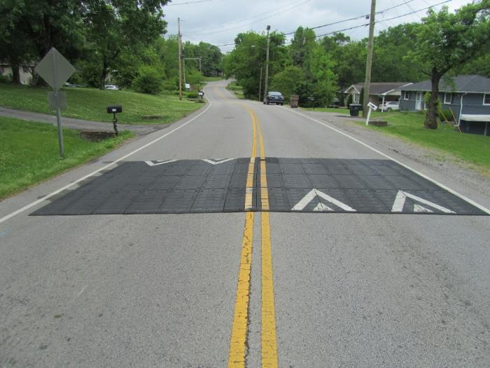
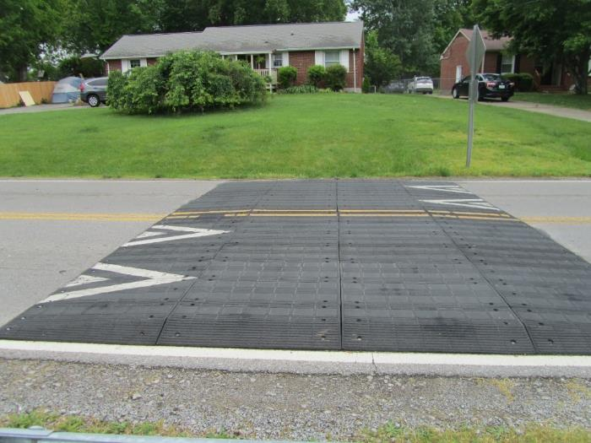
Vertical
Speed Table

Slide 18
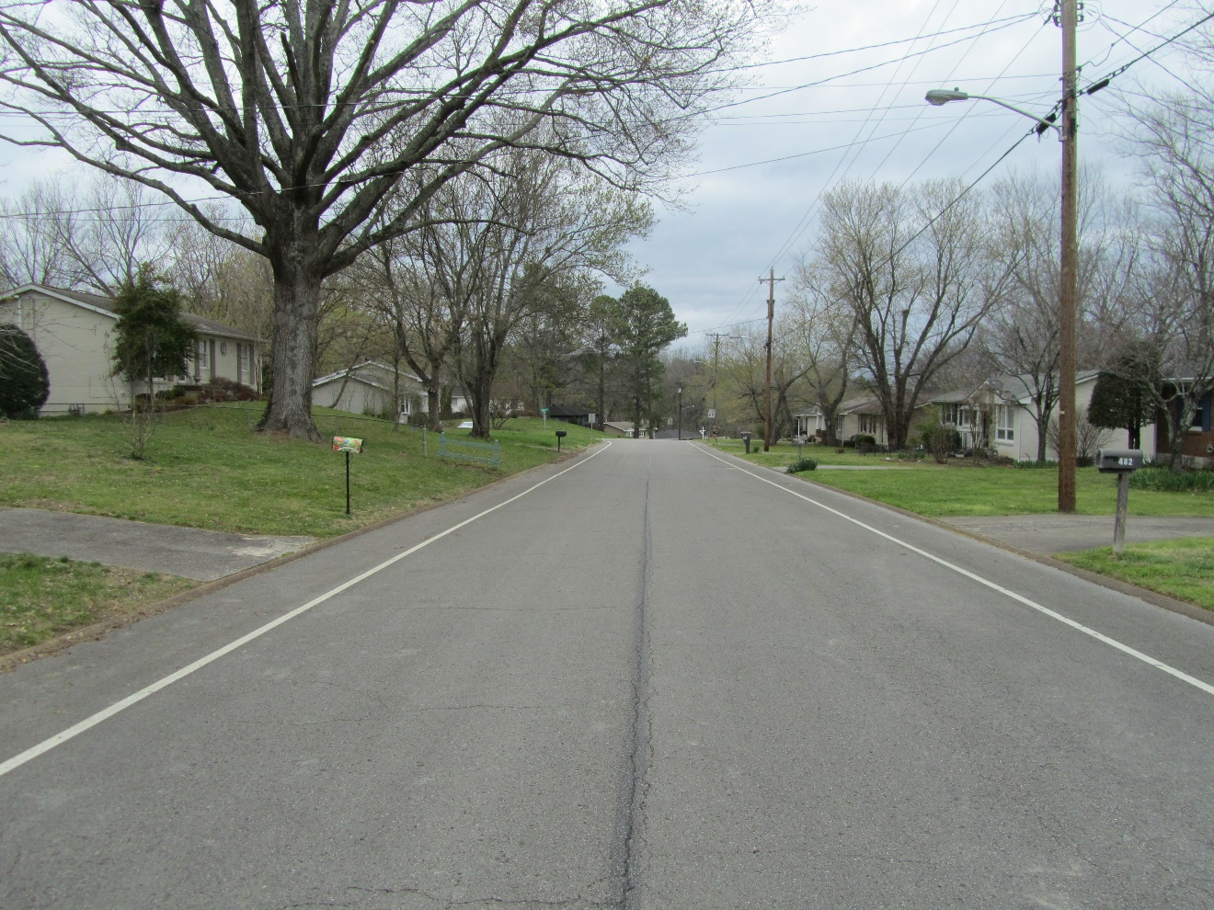
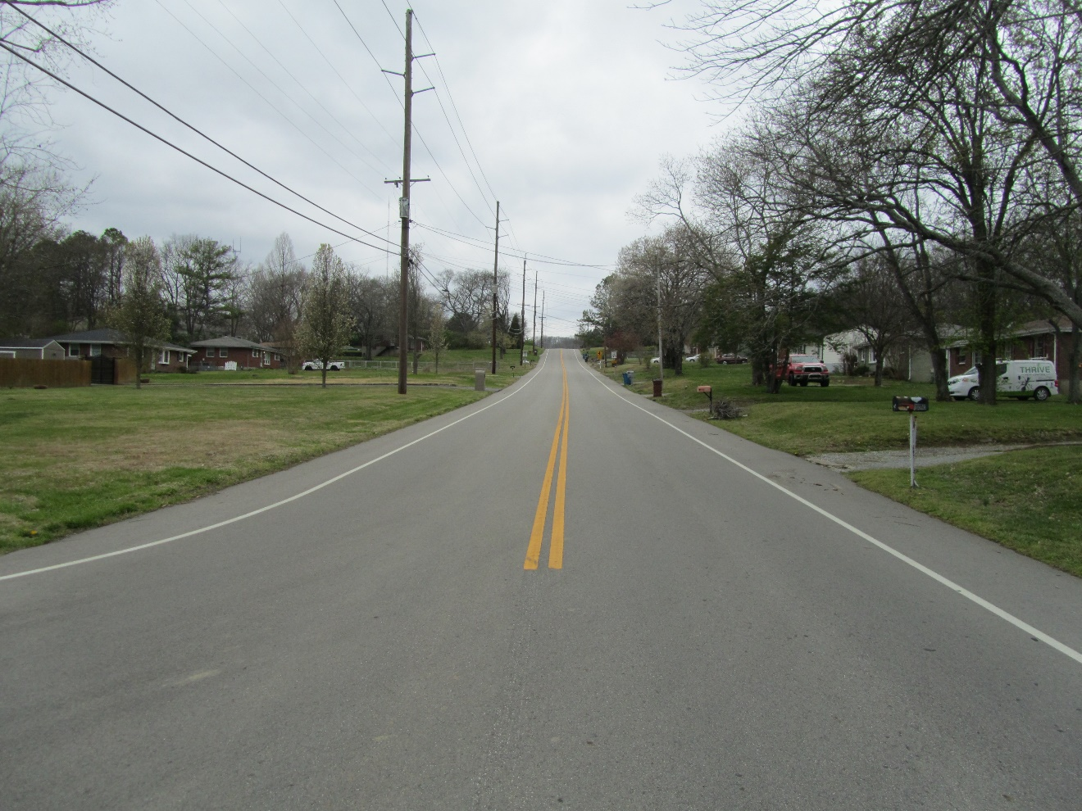
Lane Narrowing
White Edge Line Pavement Markings

Slide 19
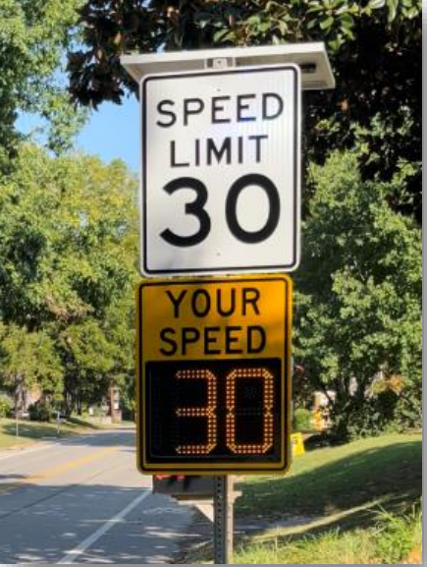
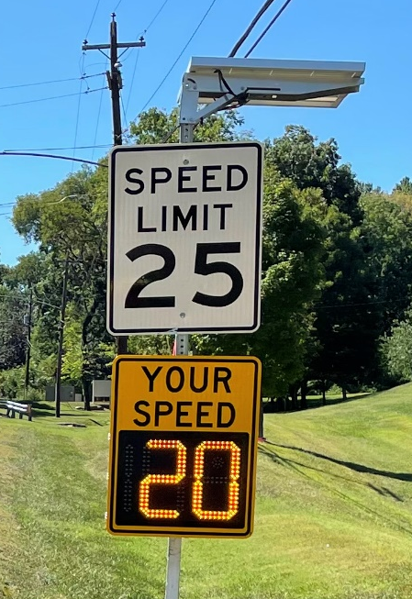
Roadside
Radar Speed Feedback Signs

Slide 20
NOT Traffic Calming
Speed Bump
“Slow Children at Play” Sign
Stop Sign
Rumble Strip
Speed Limit Sign
Crosswalks

Slide 21
Oak Hill

Slide 27

Questions

